Slide 1
Learn UNIX/Python with SASE!
By Vandana Karan
B.S. Candidate
Computer Science/Business
Notes:
Hey what’s good everyone! Welcome to my intro to programming workshops! This workshop is designed to teach everyone here a little more about how your computer runs simple programs. To do this, we will be learning a little more about the operating system Unix, and the ever so popular programming language, Python!

Slide 2

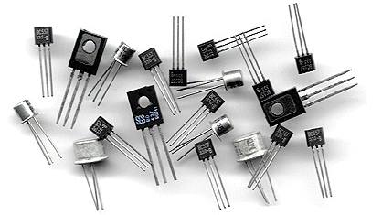
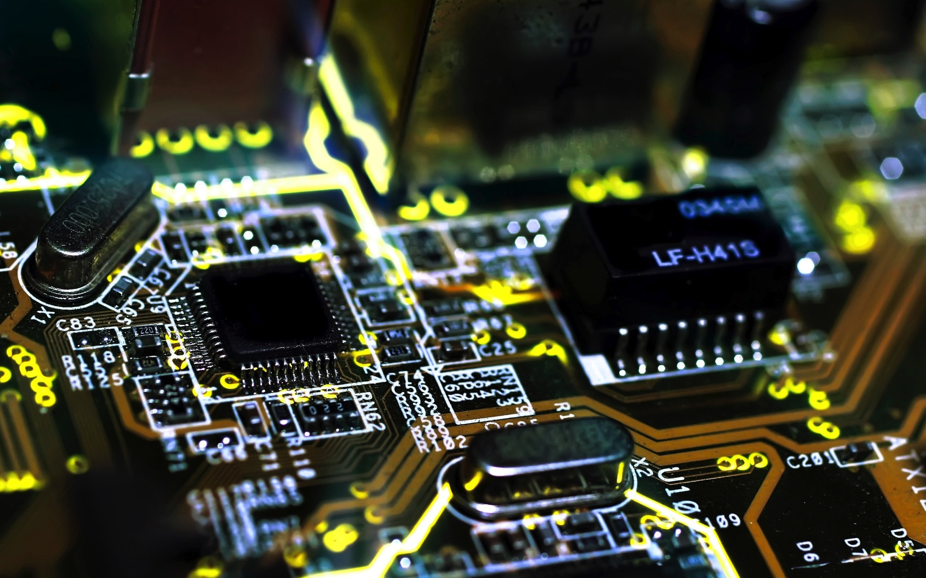
Let’s get some techinicalities out of the way…
What exactly is your computer made of?
Answer: lots of hardware! (god bless engineers)
Notes:
What do you think your computer is made of?
*ask questions*

Slide 3
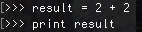
Input -> Output
How do we get the computer to do what we want it to do?
?
?
?
?
Notes:
The main point of a program that I would create is to get my computer to do stuff. How is it going to do that though? Let’s say for example, that I want to add 2+2. How’s the computer going to solve my problem?
- At the base level, the computer has it’s “brain”, the CPU. *que*
The CPU is the one responsible for handling instructions, performing computations, and eventually storing the results in main memory.
Hardware is not exactly intelligent, as it can only understand two things: 0’s and 1’s: that’s right, binary!
The CPU is going to take the instructions from memory, and decode it so that the hardware can understand it.

Slide 4
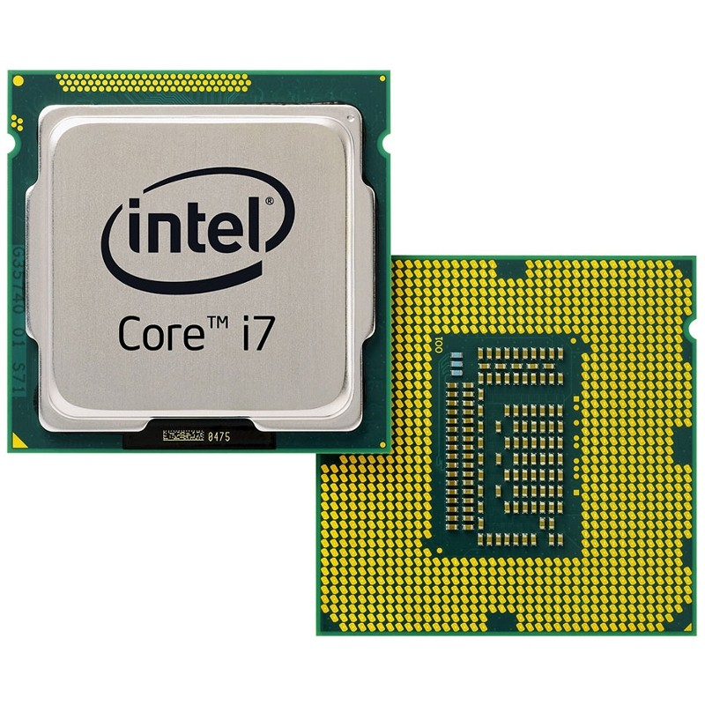

Hardware does stuff
Central Processing Unit = “CPU”
Processes instructions from memory, and stores results
Contains 32 sets of data, called “registers”
Notes:
The main point of a program that I would create is to get my computer to do stuff. How is it going to do that though? Let’s say for example, that I want to add 2+2. How’s the computer going to solve my problem?
- At the base level, the computer has it’s “brain”, the CPU. *que*
The CPU is the one responsible for handling instructions, performing computations, and eventually storing the results in main memory.
Hardware is not exactly intelligent, as it can only understand two things: 0’s and 1’s: that’s right, binary!
The CPU is going to take the instructions from memory, and decode it so that the hardware can understand it.

Slide 5
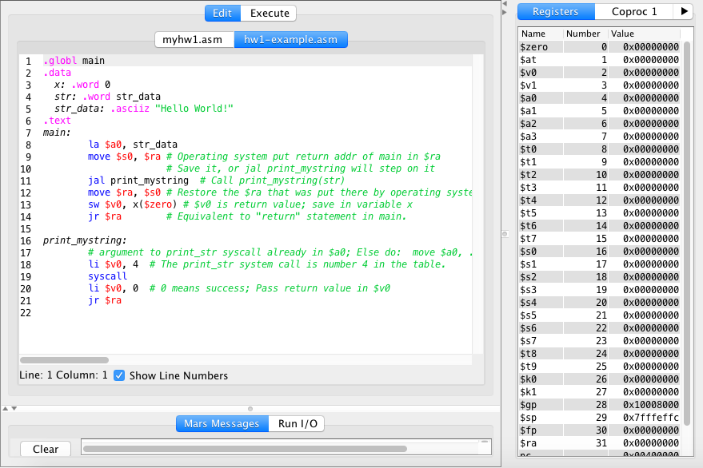
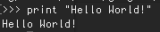
Man-made instructions: Programming Languages!
Notes:
What a compiler does: translates the python code, to assembler code, to binary code

Slide 6
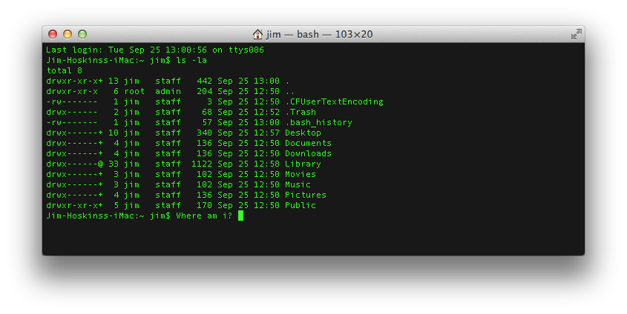
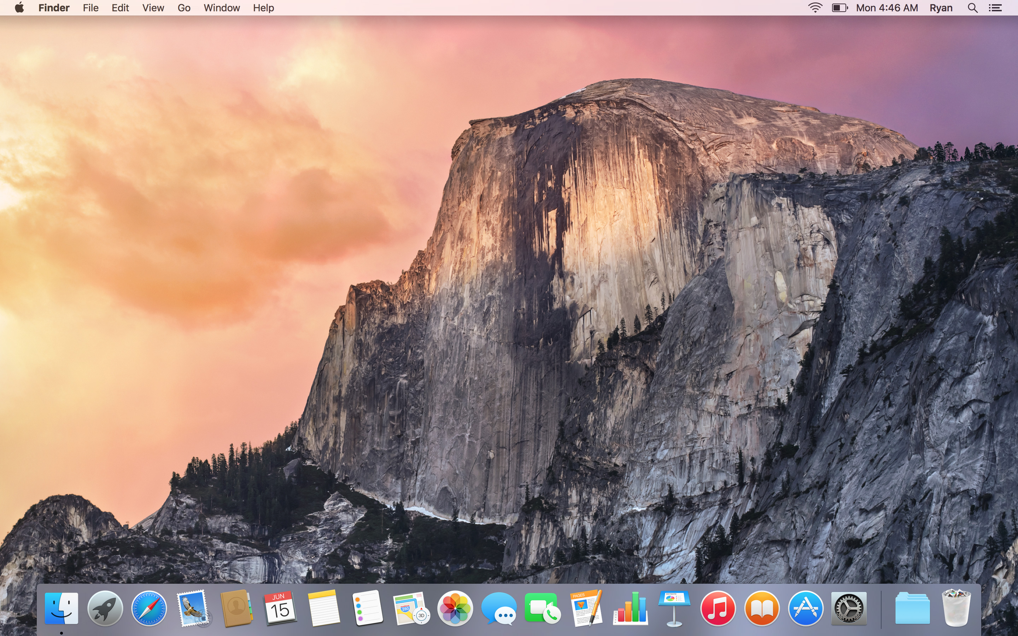
The Operating System
The Operating System was developed to manage your computers’ hardware and software
Used to be a command line interface, but has evolved!
Notes:
Made up of the CLI, and the GUI

Slide 7
UNIX
Precedes Windows
In UNIX, everything is either a file or a process!
Unix is very very simple, and simple is always better
Programs built on UNIX machines can be compiled for all sorts of architectures
Notes:
UNIX is a family of operating systems.
Can anyone tell me why UNIX is so important?

Slide 8
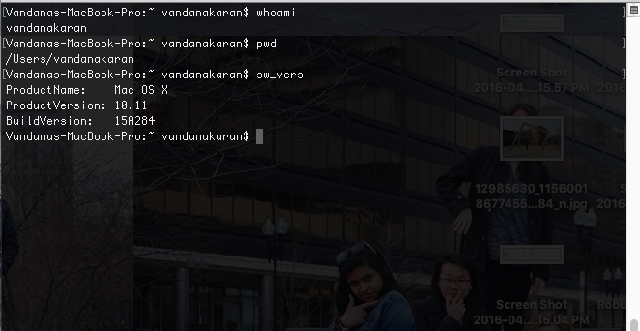
The Shell + the Kernel
Shell = CLI
What talks directly to the hardware
Notes:
The Shell is the super “hacking” looking
For Unix like systems, all operations are built on top of the commands
But, if we want to create our own commands, we can open up the shell ourselves!
Very useful for deploying commands
Like say I want to change one word of a line of code. It’s very irritating for me to just
Benefits: lots more portable
Allows me to specifically choose what I want to do
NEEDS WORK

Slide 9
UNIX deviations
Both GNU/Linux and Mac OS X are both part of the UNIX family!
What does that mean?
Similar file system, and ability to use more free and open-source softwares

Slide 10
Let’s use your shell!
Notes:
Let’s start with something easy
Whoami
Pwd
Ls
Cd
Cal
Date
Mkdir
Touch
Rm –r
Rm –rf
Lpr
Cd
Cd ..
Cp origfile new location
Mv

Slide 11
Commands
whoami
pwd
ls
cd
cd ..
cal
date
mkdir new_directory
touch new_file
rm –r file
rm –rf directory
lpr file_to_print
cal
date
Cp org_file new_loc
mv old_file new_file
Notes:
Let’s start with something easy
Whoami
Pwd
Ls
Cd
Cal
Date
Mkdir
Touch
Rm –r
Rm –rf
Lpr
Cd
Cd ..
Cp origfile new location
Mv

Slide 12
Python
Notes:
Let’s start with something easy
Whoami
Pwd
Ls
Cd
Cal
Date
Mkdir
Touch
Rm –r
Rm –rf
Lpr
Cd
Cd ..
Cp origfile new location
Mv

Slide 13

What is Python?
One of the hottest programing languages!
Known for its simplicity, and versatility
Also known for its numerous modules and libraries

Slide 14
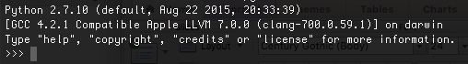
Developing Python in the shell
Simply type and enter “python”
Let’s get started!

Slide 15
Python data types
Numbers
Strings
List
Tuple
Dictionary
Notes:
Tuples and lists are similar
Tuples are read only, cannot be updated, cannot grow in size

Slide 16
Using the Twitter API
Install Tweepy!
pip install tweepy
OR
git clone https://github.com/tweepy/tweepy.git
cd tweepy
python setup.py install

Slide 17
Using the Twitter API
Make a Twitter Account!
Head over to apps.twitter.com
Click Create New App!
Enter all the information.
Get the Consumer Keys, and API keys

